Slide 1
GWC Warranty Products

Slide 2
What Type Dealer is a Good Fit for GWC?
GWC is built to understand and deliver solutions to help fulfill your dealers’ used-car operational needs. Our experience is with underwriting vehicles, providing proper premiums to provide value and eliminate exposure for your long-term insurance portfolio. Our expansive and flexible product line makes us an ideal fit for all types of dealers
Small, Mid-Size, and Large Independent Dealerships
  Gold program is designed for a more budget-conscious small to mid-sized independent, or those with their own service facility
  Platinum program is designed for the larger independent dealer
Franchised Dealerships
  Our platinum program is an ideal fit as a secondary program in a franchised dealer in an existing reinsurance position
    Opportunity for the dealer to provide coverage on vehicles not covered by their primary, vehicles that will not fit in a bank call with their primary, and protect their reinsurance book by allowing GWC to instead assume the risk on higher-mileage vehicles
Notes:
The average Franchise Dealer has 90 vehicles with over 50,000 miles in their used-car operation. It’s imperative to partner with and F&I partner who will help optimize sales and provide consumer confidence.

Slide 3




F&I Products that Drive Results
GWC Warranty provides you and your dealers with the right F&I products designed to meet the diverse needs of their used-car inventory, all while optimizing sales.
Customized Vehicle Service Contracts
  Platinum with EV
  Gold with EV
Secondary Vehicle Service Contracts
  5/100 Powertrain
  Service Lane
  Medium Duty Truck
  Certified Pre-Owned
Ancillary
  Gap Protection
DAY ONE, MILE ONE
COVERAGE
NATIONWIDE SERVICE FACILITIES
24/7 ROADSIDE
ASSISTANCE
EXCEPTIONAL
CLAIMS SERVICE

Slide 4


Platinum & Gold Protection Plans
Expansive and flexible F&I products designed to meet the diverse needs of your dealers’ pre-owned inventory
Coverage to Fit Your Dealer’s Inventory
  Current MY up to 20 years back
  Coverage for vehicles up to 200K on odometer
  Four coverage levels
  Broad spectrum of coverages available, including high-line vehicles
  Precision pricing based on twenty-plus years of claims experience

Slide 5
Platinum & Gold Protection Comparison
 | Platinum | Gold
Cancellations | Anytime, Any Reason ($50 fee at time of cancellation) | Total Loss/Repossession
Labor Rates | Market Labor Rate (No Cap) | Market Labor Rate (Not to exceed $130/hour)
24/7 Roadside Assistance | Available on All Levels | Not Available on Powertrain Plus
Rental Car/Substitute Transportation | Available on All Levels | Not Available on Powertrain Plus
Trip Interruption | Available on All Levels | Not Available on Powertrain Plus

Slide 6
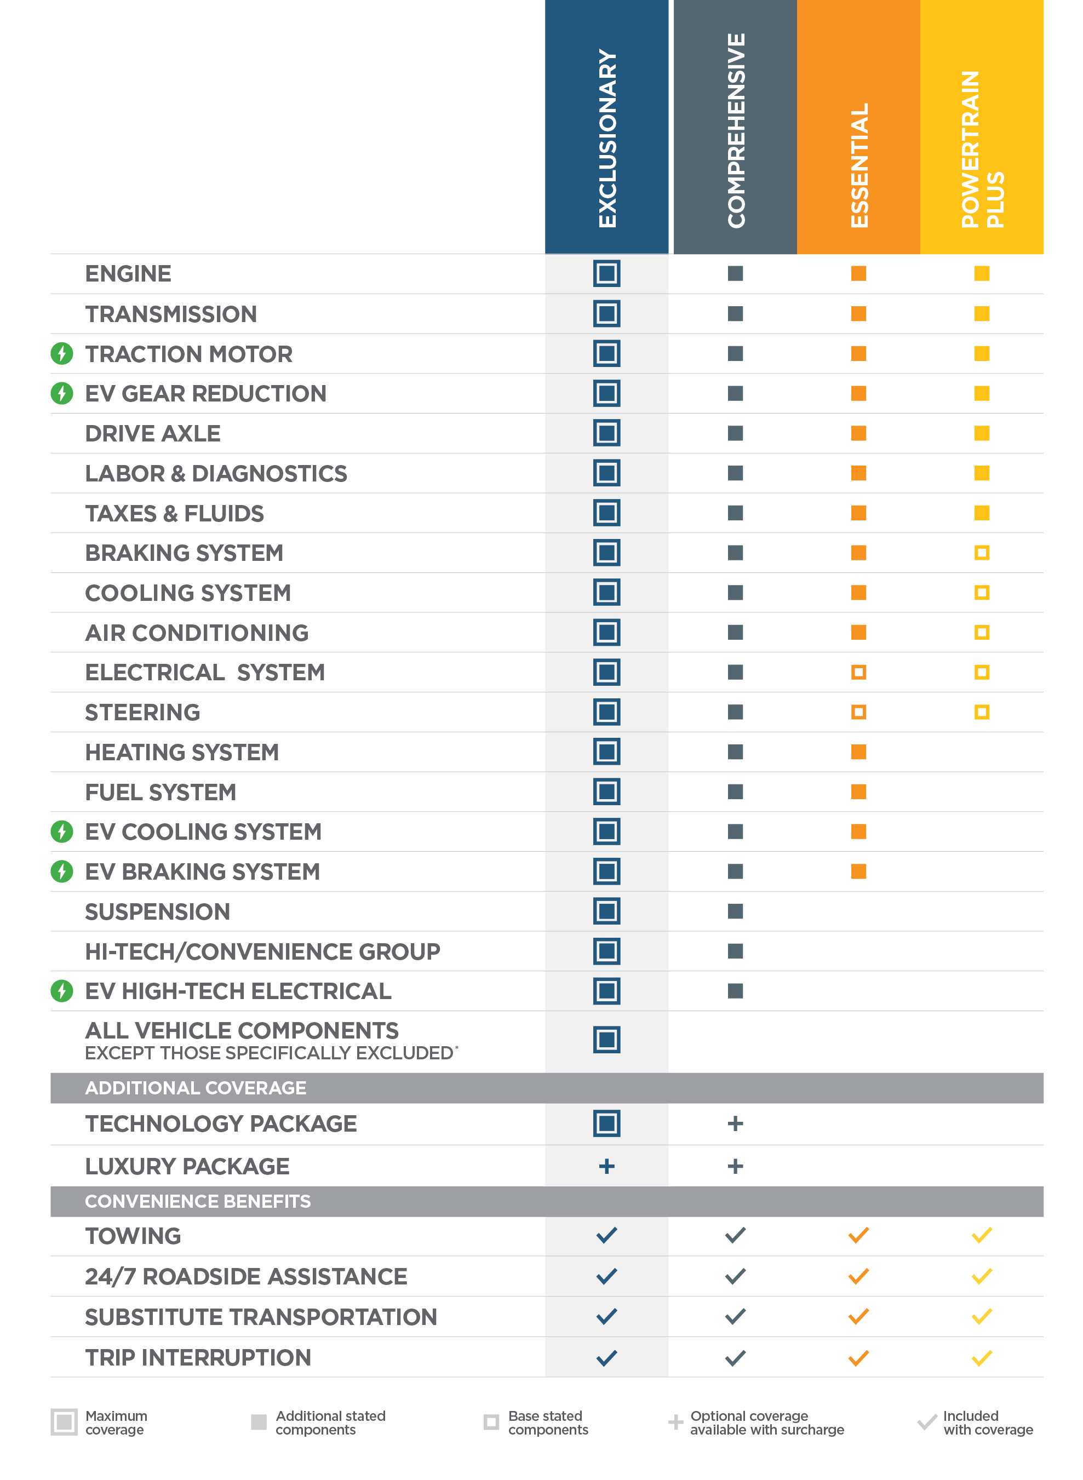
Coverage Overview
Platinum Vehicle Service Contracts
GWC Warranty’s VSC provides four levels of mechanical breakdown coverage plus roadside assistance, substitute transportation, and trip interruption reimbursement benefits for a wide range of vehicle types, including electric vehicles.

Slide 7

EV Coverage
Electric vehicles have lots of complex components that carry hefty price tags if they need repairs. GWC’s VSC includes coverage for these EV components.
TRACTION MOTOR
Primary electric drive/traction motor/generator & all internal parts
EV drive/traction motor dampener
Electric drive/traction motor mounts
Electric drive/traction motor coolant pump
EV battery
Electric drive/traction motor case
Generator case
EV COOLING SYSTEM
EV battery cooling fan motor
Radiator & coolant control valve
EV battery temperature sensor
& thermistor
EV HIGH-TECH/ELECTRICAL SYSTEM
EV battery current sensor & circuit breaker sensor
EV battery on-board charger, charge controller/power management control module, main charging switch & junction block
EV low voltage DC converter & inverter
EV throttle/accelerator pedal
position sensor
Regenerative brake control module
EV BRAKING SYSTEM
Electric brake assist booster
Electric parking brake switch
& actuator
EV GEAR REDUCTION/REDUCER BOX/TRANSFER CASE
All internal, lubricated parts & components
Gear reduction/reducer box housing, cover, oil pan, & transfer case

Slide 8




Convenience Benefits
Towing
We’ll reimburse your customer for towing charges up to $100 per mechanical breakdown for a covered repair.
24/7 Roadside
Assistance
Emergency Roadside Assistance is here to help your customer with things like emergency towing (even for a non- covered repair), battery jump starts, fuel delivery, spare tire change, and more.
Substitute
Transportation
We’ll reimburse your customer up to $50 per day, for up to 5 days, for substitute transportation like rental or rideshare if their vehicle is in the shop for covered repairs.
Trip
Interruption
We’ll reimburse your customer up to $250 per day, for up to 3 days, for meals and lodging if your vehicle is in the shop for covered repairs more than 50 miles from home.

Slide 9

Deductibles
Deductible options of $0, $100 and $250
Diminishing Deductible
  The deductible will be reduced to the amount set forth in the VSC if repairs are done by the seller or the seller group. Standard deductible reduces to $0 if customer returns to selling dealer
One-Time Deductible Guarantee
  Once a part is repaired or replaced under the terms and conditions of the VSC, any deductible amount for future repair or replacement of that part will be waived for the term of the VSC

Slide 10
Additional Program and Surcharge Changes
Lifted Trucks
  Covers up to a 6” lift
  Max tire size up to 4” above largest manufacturer-installed
  Surcharge changes to a +1 increase in class (versus previous dollar amount)
Canadian Vehicle
  Coverage is available for vehicles originally sold or leased in Canada and imported to the United States legally through channels other than the Canadian manufacturer’s official distribution system, where the factory warranty for the vehicle did not transfer.
  Pre-owned coverage only.

Slide 11
Additional Program and Surcharge Changes
Snowplow
  Snowplow coverage is available if the covered vehicle is to be used for non-commercial snow plowing, provided that the vehicle is properly equipped for such use as required by the manufacturer. If both the Commercial and Snowplow boxes are checked, coverage extends to vehicles being used for commercial snow plowing, provided that the vehicle is properly equipped for such use as required by the manufacturer. Snowplow parts and components themselves are not covered.
Commercial
  Commercial coverage is available if the covered vehicle will be used for commercial purposes, including but not limited to: rideshare services,
  pick-up and delivery service; company pool use or business travel when the vehicle is used by more than one driver; service or repair calls; job site activities; construction, farming, ranching or hauling. Commercial coverage does NOT include the use of the vehicle for livery (for rent or for hire unless used for rideshare services), emergency, taxi or police usage

Slide 12

5/100 Limited Powertrain
5/100 Limited Powertrain coverage is a
price-competitive limited liability product that allows dealers an option when a standard VSC doesn’t fit in a customer’s deal.
  Day one, mile one coverage
  Vehicles up to 15 years old and with up to 150,000 miles are eligible
  Limits of liability:
    $3,000 for engine/turbocharger
    $2,000 for transmission/4WD/AWD
    $1,500 for drive axle

Slide 13

Service Lane VSC
Service Lane coverage allows dealers to sell a GWC VSC to a customer after the date of vehicle sale.
  Service Lane is used coverage
  No inspection required
  30-day + 1,000 mile waiting period
  Vehicles up to 15 years old and with up to 200,000 miles are eligible
  Terms of 12, 24, 36 & 48 Months

Slide 14

Medium Duty Truck VSC
MDT classification is based on the gross vehicle weight rating. MDT covers such vehicles as Ford 450 and above, Chevrolet 4500 and above, Sprinter vans, box trucks, and more
Max GWVR increased to 26,000 lbs.
MDT now offers the same coverage levels as Platinum and Gold:
  Exclusionary
  Comprehensive
  Essential
  Powertrain Plus

Slide 15

Certified Pre-Owned
Realize the benefits of a Certified Pre-Owned program on used vehicles that fall outside of other CPO programs.
Differentiating your inventory from the competition with GWC Warranty Certified helps dealers drive results from their
used-car operations.
Both 3 and 6-month terms available
Vehicles up to 20 years/200,000 miles are eligible

Slide 16

GAP
Protects against financial loss in the event the vehicle is declared a total loss.
Waives the difference between the outstanding loan (or lease) payoff balance on the date of loss, and the primary insurance settlement.
GAP will cover up to $50,000 or up to 150% of the gap between your insurance settlement and your finance agreement balance.
Plus, as an optional benefit GWC GAP covers up to $1,000 of your insurance deductible.

Slide 17
GWC Profit Programs

Slide 18

Profit-Building Programs
We’re committed to working with our agents and their dealer partners to determine which of our equity programs best suit their needs and financial goals.
Cash Back Bonus Program
Wealth Builder Profit Sharing
Reinsurance
We provide full reporting and analytics to help
you and your dealers manage their programs.

Slide 19
Cash Back Bonus Programs
It’s simple! Your dealers can earn monthly cash back based on the structure below:
Dealer qualifies with a minimum of
$5,000 in net sales
Dealership must remit contracts within
31 days of VSC contract sale
Bonus payout not tied to
loss ratio parameters
Dealer will authorize program
and assign payees
Tier | Total Monthly Net Sales | Eligible Cash Amount Per VSC Remitted
1 | $5,000 - $9,999 | $25
2 | $10,000 - $19,999 | $50
3 | $20,000 - $49,999 | $100
4 | $5,000 or more | $150

Slide 20
Wealth Builder Profit Sharing
Dealers can earn up to 100% of their underwriting profits on an as-earned basis – with no risk
To qualify, achieve a monthly average production of $10,000 within the
6-month review period
Upon enrollment, dealer will earn a percentage of underwriting profits each quarter
  Dealer may withdraw up to 25% of
  the total earned underwriting profit
  each quarter
Monthly Contracts | Participation % (After Enrollment) | Participation % (Prior To Enrollment)
2 - 4 | 20% | 20%
5 - 9 | 50% | 50%
10+ | 100% | 70%
Monthly Sales | Participation % (After Enrollment) | Participation % (Prior To Enrollment)
$10,000 - $14,999 | 70% | 70%
$15,000+ | 100% | 70%
Loss Ratio | Participation % (After Enrollment) | Participation % (Prior To Enrollment)
Over 100% | 0% | 0%
100% or Less | 100% | 70%

